Slide 1
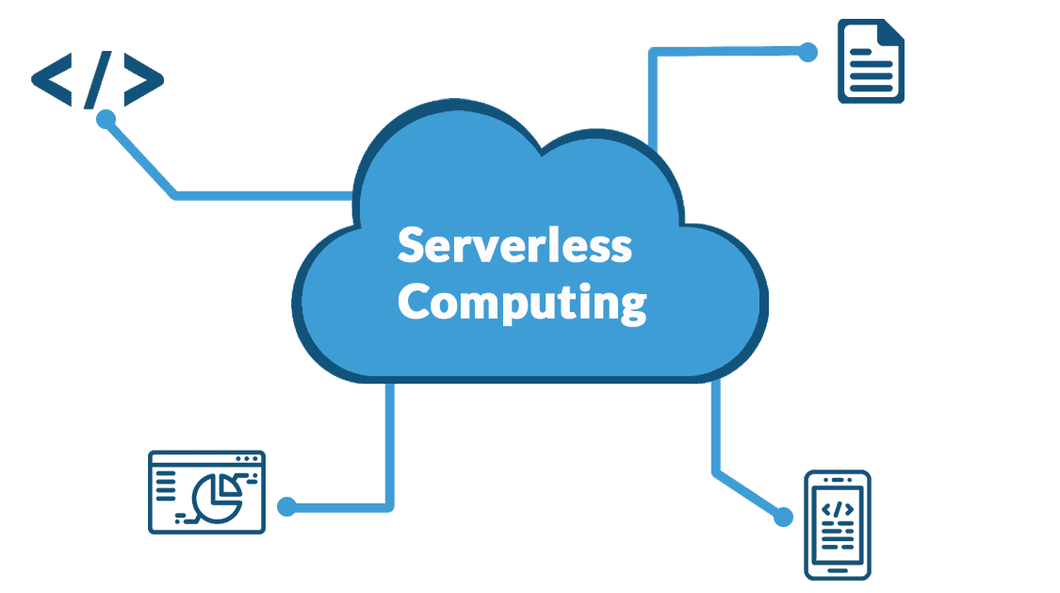
Azure Serverless Computing
Cloud providers have brought a revolution in the cloud market by introducing serverless computing services over the internet.
Many top cloud providers such as Amazon Web services, Microsoft Azure, and Google Cloud Platform have launched serverless computing.
Serverless computing provides inbuilt infrastructures and a runtime environment to develop applications rapidly.
It is the next-generation evolution of Platform as a Service.
There is no need to worry about infrastructure, scaling, management, and provisioning at all.
You can pay for the resources you consume. Whenever the application is in an idle state, you are not charged for it.

Slide 2
What does Serverless Computing do?
Serverless Computing helps users directly focus on the development part of the application rather than worrying about the infrastructure.
Developers can innovatively code for the application, whereas serverless computing can take care of the server-related requirements with flexibility.
There is no need to worry about any sort of provisioning, purchasing, and managing backend servers. It follows an architecture where vendors provide required backend services to developers.
Best Servers in serverless computing
Microsoft Azure
Azure Functions
Azure Logic Apps
Azure Event Grid
AWS
Amazon Lambda
Amazon Step Functions
Amazon SNS
Google Cloud
Cloud Functions
Cloud Pub/Sub
Oracle Functions

Slide 3
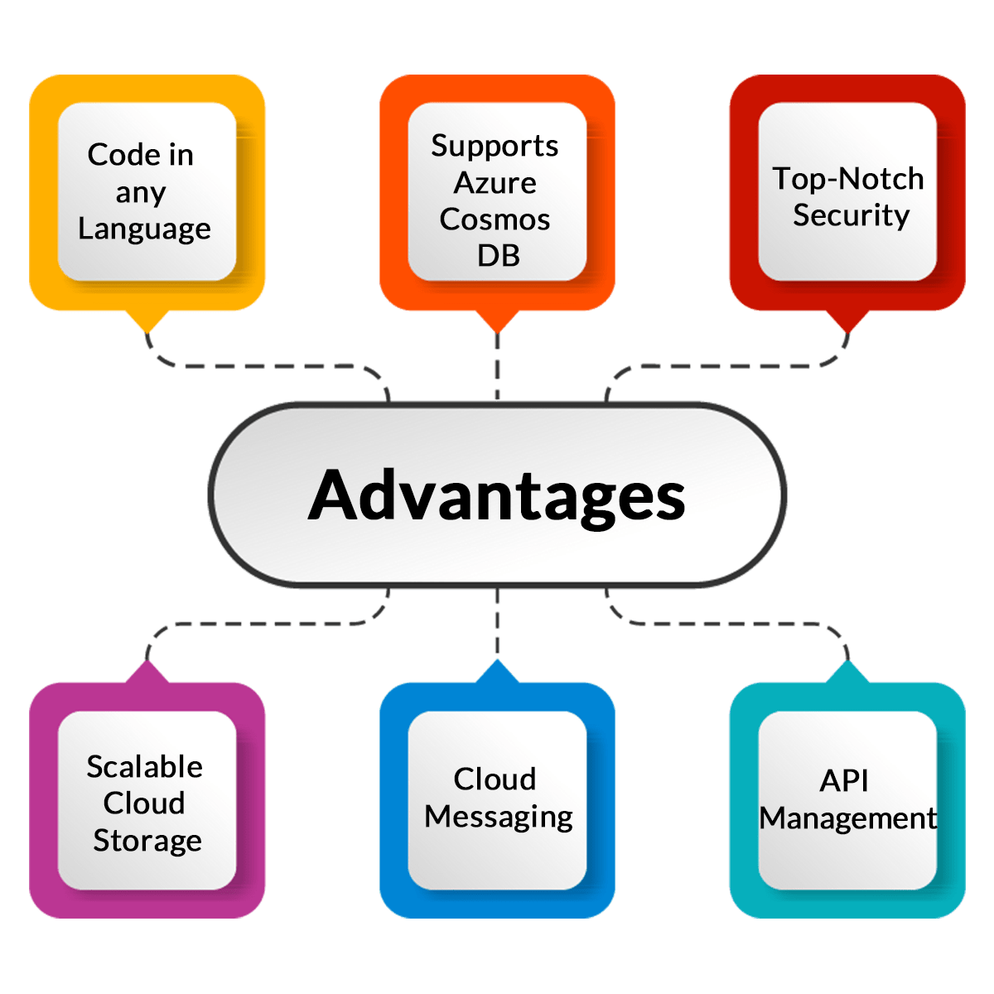
Advantages of Serverless Computing
Developers can code in any language of their choice without worrying about the servers.
Users can use Azure Cosmos DB for storing the data of their serverless applications. Cosmos DB replicates the data across regions and provides the best services to the users of the application.
Microsoft Azure provides top-notch security to developers. Azure Active Directory helps developers to access resources securely and manage their serverless applications.
Microsoft Azure provides scalable cloud storage for developers.
It helps in Cloud Messaging.
It provides API management and so many other services.

Slide 4
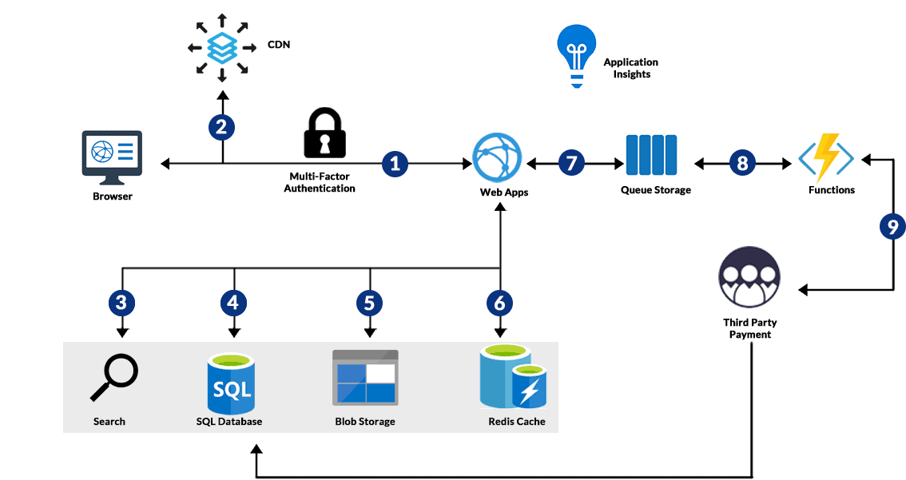
Microsoft Azure Serverless Architecture

Slide 5
Developer tools and services provided by Microsoft Azure
DevOps and Developer Tools
It provides app development tools to build, run and debug serverless applications.
It provides CI/CD for Serverless and numerous cloud-hosted private git repositories. It automatically adds package management and so many other functionalities.
Workflow and Integrations
It provides Serverless Workflow Orchestration that helps to integrate data and applications. Azure logic apps also help to design a serverless workflow.
Its Serverless Messaging feature helps to simplify event-based application scenarios with Azure Event Grid.
It also provides Azure Serverless API Management to publish, transform, secure, and monitor APIs.
Computation Services
The Serverless Function feature helps to execute the code of any language. Deployed applications can be scaled up or down on demand.
A serverless Application Environment helps to scale any API application on the user’s own choice.
Serverless Kubernetes provides services for orchestration capabilities and virtual nodes.
Database
Users can use Azure Cosmos DB as it is a serverless database that is scalable, globally distributed, and multi-model database service.
Monitoring Services
Azure Serverless Monitoring helps to observe the application after deployment.

